Slide 1
HIV programme review in the Republic of Moldova: Mission debrief
Stela Bivol
Unit lead Joint Infectious Diseases
Country Health Programmes
13 February 2023

Slide 2
WHO HIV Mission Team
Prof Natalia Nizova, consultant – Governance and overall coordination of the national response
Prof Alberto Matteelli, consultant – TB HIV coordination, management, and integration
Alexandre Lourenco, consultant – financing HIV response
Giedrius Likatavicius, consultant - key populations, prevention, service delivery, communities, enabling environment
David Otiashvili, consultant, OAT
Pavel Khaykin, consultant, HIV treatment and co-morbidities management
Irina Andrianova, consultant (Laboratory) – HIV testing policy and practice, testing and diagnostic algorithms and laboratory services
Giorgi Kuchukhidze, Epidemiologist (HIV, viral hepatitis and TB), WHO/EURO - epidemic patterns, HIV surveillance and M&E system
Viatcheslav Grankov, HIV Medical Officer, WHO EURO – HIV prevention, service delivery, testing and treatment, TB-HIV
Stela Bivol, Unit Lead, Joint Infectious Diseases, WHO EURO

Slide 3
Scope of HIV Programme Review
Objective: to assess the progress and challenges faced in implementing the National Program on HIV and sexually transmitted infections 2022-2025 and to provide recommendations
Key Focus Areas
Governance and overall coordination
Sustainability and financing, service delivery, including decentralization
Epidemic patterns, surveillance and data systems
Prevention services for key populations and other groups
OAMT
HIV testing policy and service delivery and the lab component
HIV treatment policy and service delivery
TB/HIV coordination, management, integration

Slide 4
Methods
Based on WHO tool kit for Conducting Programme Reviews for HIV
Phase 1: Desk review
Phase 2: one week in-country mission
Deliverables
Preliminary findings and recommendations presented at the end of country mission
Draft report with findings and recommendations one month following the mission.

Slide 5
Details of the mission February 6-13, 2023
Institutions/organisations | Meetings
Public institutions | Ministry of Health, Ministry of Finance, CNAM, ANSP, CAPCS, National HIV Program team, National TB Program, Republican Narcology Dispensary, PCIMU, TB/HIV program coordination Transnistria region, Ungheni district specialist clinics, Penitentiary no. 16 Pruncul & Penitentiary no. 9, Department of social assistance and child protection, Health Section, Balti Clinical Hospital / Regional ARV Treatment Center, Narcological Cabinet, Family Doctors Center / Health Center No. 1, Regional Social Centers
Community-based, non-governmental organisations, discussions with key populations | Service providers and beneficiaries: people who inject drugs, sex workers, men who have sex with men, people living with HIV AFI, Community PULS, Gender DOC-M, KAP Committee Initiativa Pozitiva, PAS Center, the League of people living with HIV, Union for Equity and Health
Multi/bilateral partners/international organisations | CCM, UN Team, UNODC

Slide 6
Supporting Member States to reset disease response investments
What shifts are needed in countries?
From
To
Through greater support to
Blanket approaches
Data driven program decisions highest priorities and geographies
Curating data, improving data for action
Siloed programs and models of care
Shared innovative approaches across service platforms and comorbidities.
Service mapping, design, policy options incl. for virtual outreach, digital health
Donor supported high-impact programs
Country owned well-designed high impact scaled-up response
Essential service packages, polyvalent health and community workers
Single disease diagnostic networks
Multidisease capabilities at lower levels of care
Diagnostic network assessment and planning for multidisease capacity
Disease response impacted by emergencies
Dual track approach to overcome disruptions
Maintaining essentials, efforts to catch up, build resilience, cross border continuity and data exchange

Slide 7
Overall findings
The National HIV/STI program has the right strategic focus for the current epidemic trends and the potential to achieve impact. However, it needs to be more data-driven in adjusting programs, deploying technical approaches, reaching new groups and adjust geographic focus.
Technical approaches to HIV prevention, testing, treatment and care are well aligned to WHO recommendations and the innovations are well positioned to show added value and achieve more impact. The key is quality of execution, effective implementation, continuous learning and maintaining the ambition to experiment then rapidly bring to scale.
The coverage targets are not fully aligned to international commitments, but if achieved by 2025, Republic of Moldova will be well-positioned to reach the 95/95/95 goals by 2030.
The Republic of Moldova is ahead of the curve in maturity of its national institutions and their capacity to ensure programmatic take-over of donor supported services and procurements, but few improvements are needed, i.e. capacity to ensure service continuity for prevention of contracted services for KPs and capacity to procure from international platforms.
The Republic of Moldova is well positioned to align its national programs for HIV/STI, viral hepatitis, TB with the Regional Action Plans to end AIDS and the epidemics of viral hepatitis and STIs 2022-2030 and the TB Action Plans for the European Region 2023-2030 and consider overseeing these national programs under a single coordinating body post 2025.

Slide 8
Integrated people centered services and differentiated services
Progress | Challenges | Recommendations
Many examples: Successful experience of decentralization of ART delivery and monitoring Multimonth dispensing (1, 3, 6 months) Providing Hep B, C services for KPs and PLWH; HIV/Syphilis dual testing Examples of effective integration of health and social services. HIV/syphilis and hep B testing performed in ANC. | The concept of service integration (medical-social) and decentralization esp in Chisinau not yet agreed upon. Payment mechanisms of integrated and decentralized services not well developed. With decentralization, stigma and discrimination in public health systems becomes an imperative to address. | Explore service integration of other diseases in HIV service delivery platforms and also stronger integration of HIV, viral hepatitis and STIs into PHC and sexual and reproductive health services. Design payment mechanisms for decentralized outpatient care Consider EMTCT triple elimination goals.

Slide 9
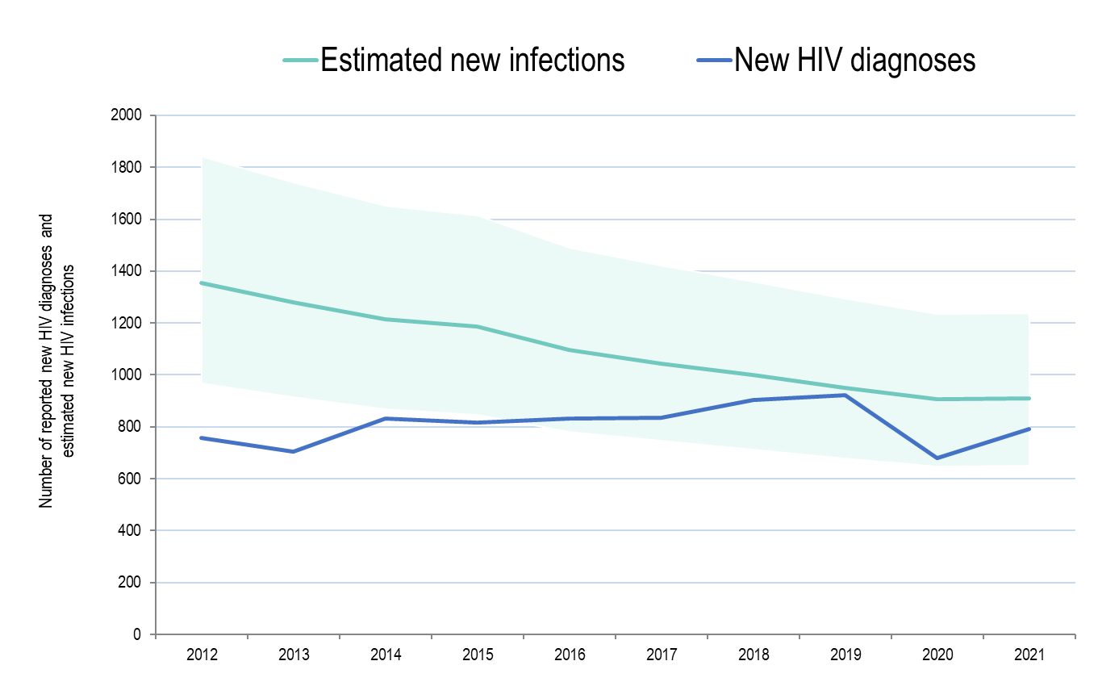
Context
3.27 million population (UN Pop.) [2.80m with 2014 census]
HIV prevalence 0.3%
15 249 PLHIV (2021 estimates)
10 139 PLHIV diagnosed (66%)
84% among women vs. 56% among men
7 267 PLHIV on ART (72%)
6 473 VLS (89%)
Total PLHIV diagnosed 16 106 (2022)
63.7% men
Deaths 4 656 (2021)
PLHIV alive 10 139 (2021)
929 new HIV diagnoses (2022)
836 initiated ART (90%)
1st 95 among KP
SW – 62%
MSM – 48%
PWID – 50%
*Shaded areas represent uncertainty intervals around the best estimate
The proportion of undiagnosed HIV is not declining

Slide 10
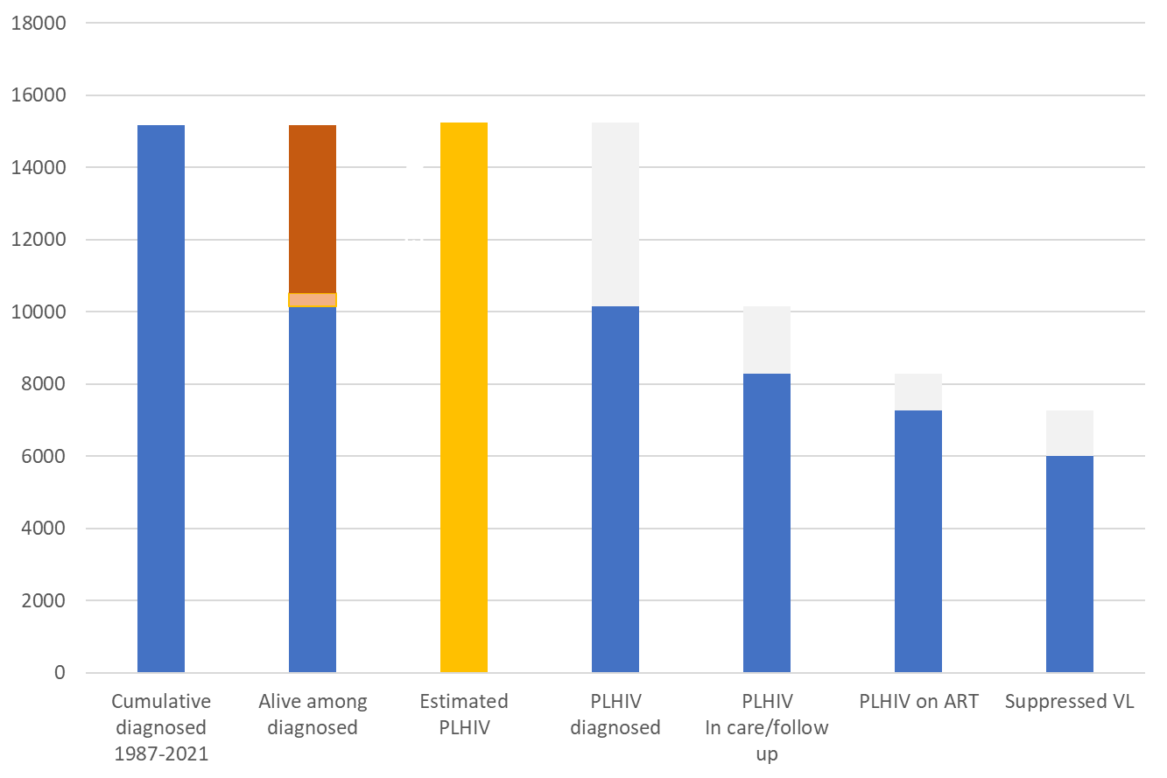
HIV treatment and care cascade in Moldova (2021)
A special study was conducted to characterize newly diagnosed individuals in 2019 and 2020 who did not start ART*
Of those diagnosed but not on ART, 40% died and 60% did not reach specialized care at all
These are mainly people diagnosed in the hospital sector, typically over 40, and most of them do not know their HIV status*
33% died
AIDS related
66%
72%
89%
*study conducted by SDMC in 2021

Slide 11
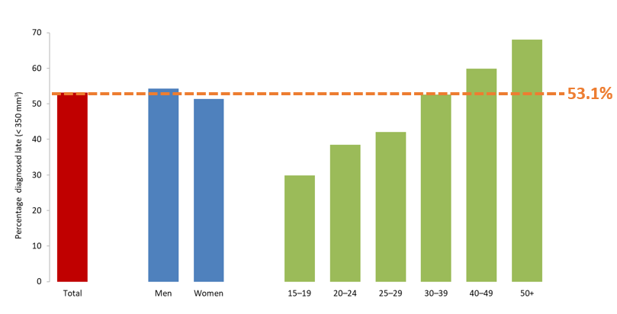
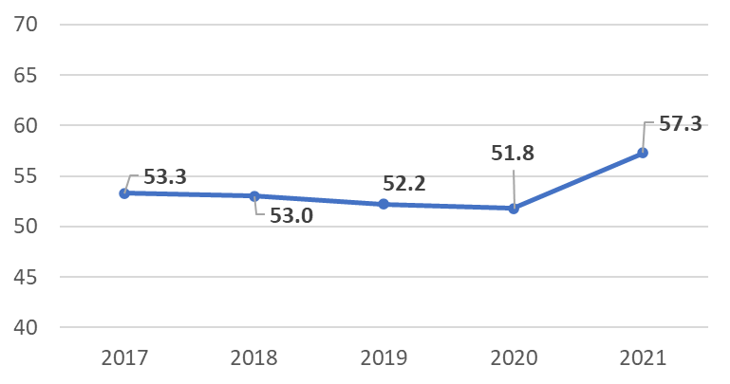
Late HIV diagnosis in Moldova
Proportion of people diagnosed late (CD4 cell count < 350 per mm3) by gender and age 2017-2021 (n = 3 331)
Percentage of people with HIV diagnosed late increases with age and is highest in people over age 50 (68%)
32% has CD4 cell count less than 200 per mm3
The proportion of late diagnosis increased slightly in 2021, likely due to the impact of COVID-19
Proportion of people diagnosed late (CD4 cell count < 350 per mm3) in 2017-2021

Slide 12
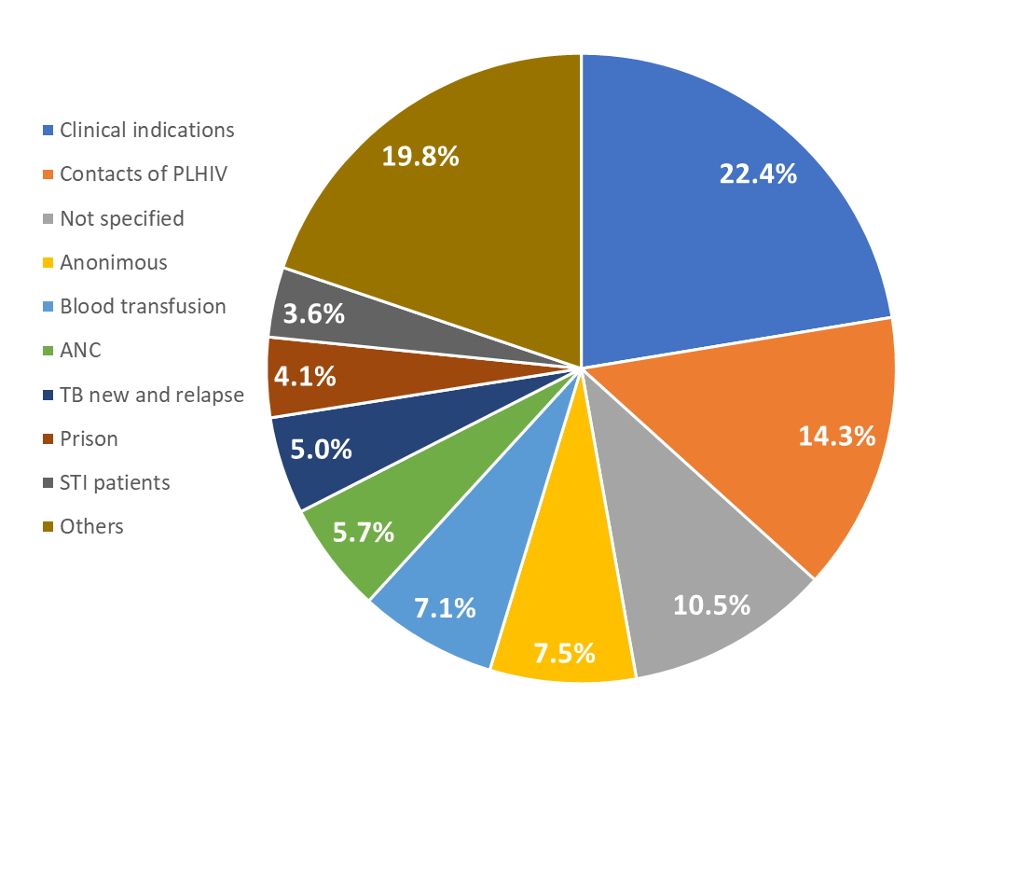
Distribution of infection by population/groups (routine data)
HIV testing codes among PLHIV diagnosed during 2018-2022
MoT, routine data in Moldova
2012-2021
56%
KP may hide under the groups with clinical indications, the groups whose testing reason is not specified and those who are tested anonymously
The same groups plus contacts of PLHIV may also represent ‘bridge population’, clients and partners of KP
MoT for 24% of all diagnosed HIV are unknown
What’s the role of the “bridge populations”?

Slide 13
Epidemic among key populations
KP | HIV prevalence | PSE
PWID | 13.9% (2017) 11.4% (2020) 8.1% Chișinău – 14.9% Bălți – 23.5% Tiraspol | 27 500 (2020)
MSM | 9.0% (2017) 11.4% (2020) 11.6% Chișinău – 8.55% Bălți | 14 600 (2020)
SW | 3.9% (2017) 2.7% (2020) 2.1% Chișinău – 4.4% Bălți | 15 800 (2020)
Prisoners | 3.8 % (2017)

Slide 14
PMTCT
Impact Indicators | Result (2021) | Result (2022)
MTCT of HIV rate of <2% in non-breastfeeding populations | 6.4% | 1.0%
A case rate of new paediatric HIV infections due to MTCT of ≤250 cases per 100 000 live births | 38 | TBC
Process/programmatic indicators
≥95% ANC coverage (at least one visit) | 95.7% | TBC
≥95% HIV testing coverage in pregnant women | 99.6% | TBC
≥95% ART coverage in pregnant women living with HIV | 94.5% | TBC
Over 65% of MTCT cases could be contributed to the situation where pregnant women remained outside of the medical care (27%) or were not tested or tested negative for HIV (38%)*
*Assessment of Barriers to Pregnant Women's Access to PMTCT, 2019-2021

Slide 15
Strategic Information and data collection tools: achievements
IBBS among SW, MSM and PWID is conducted on a regular basis and with a sound methodology
Additional implementation research studies looking at the various programmatic issues are also conducted regularly, and the results are available
Moldova is the only country that does the subnational estimation of HIV epidemic (by right and left banks)
Data on HIV prevention services among KP are captured in the electronic database, using personal anonymous magnetic cards

Slide 16
Strategic Information and data collection tools: challenges
The first 95 is low overall and especially among men
28% of diagnosed do not start ART (low 2nd 95)
Of those newly diagnosed with HIV who do not start ARV, 40% die and 60% do not reach specialized care at all*
Parallel data recording and reporting systems in National Public Health Agency and SDMC
Excel-based electronic registries are in use, which increases the high risk of data quality issues
Existing routine (surveillance) data on modes of transmission substantially underestimate the role of key populations and their partners in the HIV epidemic
Despite the availability of data, it is not being used to inform policy and develop tailored interventions for HIV prevention and care, esp. at subnational levels
* Based on the study conducted by SDMC in 2021

Slide 17
Strategic Information and data collection tools: recommendations
Develop an electronic database on HIV/AIDS, including clinical and surveillance data and link to an existing electronic system used by NGOs [to share data on linkage to care for KPs]
Have one database for both entities (SDMC and NPHA) to get rid of extra recording and reporting
Conduct a study on the misclassification of modes of transmission [for routine data]
Revise the HIV case notification and epidemiological analysis forms to improve the quality of data on high-risk behaviors and transmission routes
Align the M&E plan of the national program with the Regional Action Plan for HIV, viral hepatitis and STIs (mid-term of post 2025).
Increasingly use data from both routine and non-routine sources to tailor programs and interventions at subnational levels and for highest priority.

Slide 18
Governance and overall coordination: achievements
Structures and policies in place for an effective HIV response:
The current program management system is the result of the implementation of the National Health Policy for 2007–2021, whose goal was to form a national public health system. New strategy until 2030 is under development and close to finalization.
National Program on HIV and STIs 2022-2025 approved by the Cabinet of Ministers of Moldova, costed, funded with clear M&E, roles and responsibilities.
Significant progress made in strengthening coordination units of HIV/STI and TB programs.
MOF is implementing a financial management system based on the application of long-term strategic planning (including donor funds) and the creation of action plans (targeted programs).
CNAM – National Health Insurance Agency is an effective mechanism to both fund the HIV and TB services at all levels of care, including specialist outpatient, primary care, community-based care and strategically shape services towards decentralization and integration.
CAPCS – an effective institution in procuring key commodities at affordable prices, and ensure their uninterrupted supply.
ANSP - National Public Health Agency (NPHA) established by the Decree of the Government of Moldova in 2017. Currently under functional review and plans to amend the Public Health Law (2009) and update the mission and responsibility NPHA – an opportunity to clarify its role in the coordination and implementation of national programs.
A unit of national programs has been created in the Public Health Department of the Ministry of Health.
CCM - a multisectoral decision-making body representing all constituencies - an effective mechanism for participatory decision-making.
KAP Platform- body to ensure meaningful engagement of communities into the HIV response.
Competent, professional implementers in public and non-government sectors and strong coordinated technical support from international partners.

Slide 19
Governance and overall coordination:Challenges
The vision of the new model for joint management and improved coordination of integrated HIV/STI, TB and Hepatitis (planned for 2021) not yet finalized.
The existing management structure of the HIV/STI National Program has managed to improve delivery of key components of national HIV response, yet has some functional limitations:
Limited authority and mandate at local level and over levels of care other than specialized
Duplication and fragmentation of coordination and functions (monitoring and evaluation, procurement)
Insufficient intersectoral coordination in the implementation of program activities, as well as between the national and regional levels (the main resources for coordination are concentrated in medical institutions at the national level).
The NPHA has a large human resources potential (1600 employees) and a structural vertical in the regions (10 regional offices), but has limited mandate in the collection of epidemiological data on HIV.
Sustainability and duplication risks due to the limited mandate of the current PR of the Global Fund (PCIMU) in the implementation of the national program. This is determined by its status as an independent state structure under the Ministry of Health, specifically established to perform the functions of project implementation unit, including as a principal recipient of a GF grant. Role predominantly focused on procurements of goods and services, effective technical management and donor reporting.

Slide 20
Governance and overall coordination: Recommendations
To conduct a functional review and develop optimal configuration of the coordination of national programs with the key components (monitoring and evaluation, prevention, diagnosis and treatment, resources and finance), ideally in a single structure, ensuring a rapid increase in its capacity using the experience gained and human resources generated under previous GF programs in Moldova.
Based on the results of research on the reasons for the ineffective coordination of the national program implementers at all levels, develop an action plan to create a sustainable communication mechanism to establish operational communication between all stakeholders, including possible emergency situations in the process of implementing program activities.
Develop a clear strategy to increase functional capacity of national entities in strategic purchasing of services that are able to achieve program outcomes, ensure adequate levels of funding and service continuity, and procure the whole range of products including through international platforms; mechanisms that ensure integration and removing duplication and fragmentation in the program coordination; protect the role of national non-government implementers.

Slide 21
Financing
Moldova’s progress in HIV financing is remarkable (e.g., full coverage of ARV medication costs, CSO contracting), demanding the definition of more challenging goals in the years ahead.
HIV/AIDS program financial management would benefit from a more integrated governance system and a progressive integration of functions and technical capacities into regular public administrative services (e.g., within a revised multiannual contracting framework, CNAM can fully assume CSO contracting to replace the UCIMP role).
Services decentralization and the development of ambulatory services will require the introduction of more effective outcome-based payment models (e.g., bundled payments combined P4P)
OAMT services contracting can be improved by moving to bundled payment model (per patient covered)
Due to its financial unsustainability, the phasing out of the diagnosis incentives payment to GPs should be planned

Slide 22
Procurement
The procurement agency represents a breakthrough in the financial management of medicines and medical devices.
Even though procurement is based on technical advice, more accurate forecasting methods can significantly reduce waste.
Integrating procurement and logistics inventory management through the implementation of logistics management system software (LMS) has an enormous potential to increase efficiency in managing medicines and other supplies.
The possibility of acquiring medicines through international suppliers (e.g., GDF) should be analyzed to reduce acquisition costs.
The reporting to the WHO Global Price Reporting Mechanism can support national decision-making.

Slide 23
Enabling environment and community engagement: progress
National legislation aligned to EU provisions on equity and reducing stigma and discrimination based on HIV status or sexual orientation (i.e. employment, education, adoption etc)
Modified national provision with regards to prohibiting using HIV-positive status as grounds for refusing adoption or custody/guardianship of children
Stigma index is regularly performed and shows positive dynamics
Roadmap of the PLWH destigmatization process is available and in process
Moldova is a pilot for UNAIDS inequity tool – an opportunity to document and reduce further inequities, including gender-related ones
Vast network of NGOs and CBOs representing most key population constituencies, well-organized and well represented in decision making bodies; strong capacity for leadership, advocacy rights-based responses and removing barriers.
Community-led monitoring mechanisms in place, including access, quality, monitoring of human rights violations (REAct platform); strategic litigation cases are taking place; legal support to KP and PLHIV available.

Slide 24
Enabling environment and community systems and engagement: challenges
Despite not being enforced, provisions in the law still criminalize HIV exposure and transmission (disease specific article 212)
Criminal code singles out AIDS as an aggravating factor in several articles related to sexual violence and trafficking
Issues with medical personnel observing the right to privacy and confidentiality and high level of stigma and discrimination still persist, esp. in districts and rural areas
Penalization of sex work creates additional barriers in ensuring safer practices and access to services
Issues of criminalization of drug possession and use
Additional challenges with human rights violations mentioned on the Left Bank
While community-led monitoring mechanisms have been strengthened and are generating data, their systematic linkage and interaction with coordinating institutions on a routine basis remains limited
Although community members are well represented and included in decision-making multisectoral mechanisms and participate in program planning processes, they consider that in some cases their voice and causes are not acted upon by high level decision makers

Slide 25
Enabling environment and community systems and engagement: recommendations
Adjust criminal code by removing art 212 of Republic of Moldova; amend code on the disclosure of confidential information.
Adjust the legal framework in line with the recommendations of international organizations on decriminalization and/or depenalization of drug use for non-medical purposes and drug possession for personal use, including the quantities for personal use; de-penalize sex work.
Focus on interventions aiming to reduce stigma and discrimination among medical workers, esp. in light decentralization. Include in CME module on medical ethics and stigma reduction.
Address inequalities in HIV services access and outcomes, and close the gaps that exist in specific localities and for certain groups
Focus on systematic linkage of CLM generated data to routinize feedback and establish regular accountability mechanisms
Support and effectively resource community-led responses to navigate fulfillment of sustainability and transition, policy and legal environment changes

Slide 26
Prevention in key populations: achievements
Progressive environment and public commitment to prioritize key population programs
Wide network of community-based service provision
Well-established comprehensive services in penitentiary sector, including OAMT and NSP, with good collaboration with public sector.
Legislation:
National HIV program 2021-2025 includes KP component as a priority
Standards for Harm Reduction were approved in 2020;
National clinical protocol on NPS has been approved in 2022
Introduction of a range of innovative approaches of service delivery, including sites (pharmacies), through mobile units and online outreach:
Vending machines for provision of commodities
Web outreach to provide information and improve access to integrated services
Monitoring of prevention services via a real-time database
UIC for all KPs with visualization tools by different criteria
Integration of services and collaboration between public and community platforms:
Interaction between public social centres and NGOs (Renasterea and PLHIV League in Chisinau, Equity and Health and Social Center in Balti)
Penitentiary institutions and NGOs (e.g. prison in Chisinau and NGO Initiativa Pozitiva);
Youth clinics and NGOs providing services to KPs (example of ATIS, Balti);
NGOs to cover several KPs

Slide 27
Prevention in key populations: challenges
Service coverage with prevention not sufficient to reduce transmission in certain populations.
e.g. MSM: 29% received prevention interventions and 30% received HIV testing.
Further analytical inquiry of the behavioral profile of newly HIV diagnosed is needed: 50% of identified cases from rural areas, who are not matching the profile of key population networks currently reached by KP programs.
Changing drug scene -> traditional harm reduction approaches may not be suitable for new and young people who use drugs. Validation criteria are not flexible to include non-injecting groups of people who use drugs, NPS etc.
Insufficient integration of TB and HIV services at the NGO level to provide services to key populations.
Delayed adoption of service package costing at the national level
Limitation of outcome payment mechanism (per people covered) and inconsistency with reporting:
Payment that is 100% dependent on coverage incentivizes reaching quantitative indicators, reducing the quality of services
While payment focuses on result, the reporting focuses on the process;
Lack of continued service delivery for prevention services provided by CNAM

Slide 28
Prevention in key populations: recommendations
Due to documented continued HIV transmission, prioritize strengthening MSM program: expand reach, including geographic and into more hidden populations; improve service package, including improve attractiveness and quality.
Focus on the continuation of provision of services for PWID. Reach non-injecting users, while adjusting validation criteria to allow coverage of users of new drugs, where transmission risks have been confirmed. Continue documentation of risks and evidence of higher HIV prevalence.
Based on the analysis of profile of newly diagnosed, tailor geographic reach where pockets of transmission are documented.
Further refine payment mechanisms to ensure service continuity, increase focus on quality, reduce incentives to focus only on coverage and incentivize performance. Combination payment methods could include:
capitation+per service;
capitation+pay-for-results (reaching high testing coverage among those covered with prevention; new HIV detection.
Further seek integration of TB and HIV services for key and vulnerable populations.

Slide 29
OAMT: Context
OAMT available in Moldova since 2004 in civilian sector and since 2005 in prisons
OAMT is an essential part of HIV/AIDS Program 2021-2025 and National anti Drug Strategy 2020-2027
Since 2019 funded by the state - health insurance
Currently available through 10 sites in civil sector, 13 sites in penitentiary system
Buprenorphine introduced since 2018
Methadone and buprenorphine included in the list of essential medicines and procurement done by the state
Dosing: 60-70 mg for methadone, 12-14 mg for buprenorphine
Focus on long-term treatment

Slide 30
OAMT: Achievements
Sustainability ensured through policy and funding arrangements
Beneficial collaboration and TA from multilateral partners (UNAIDS/UNODC/WHO)
Take home dosing (originally introduced during COVID) implemented on a reasonable scale – 35-70% depending on a location
Innovative solutions
mobile application for OAMT, plastic cards, electronic system
video supported treatment to be introduced; video visit will be equal to face-to-face visit
Clinical protocol regularly updated (to reflect the changing drug landscape and evidence)
The system is able to rapidly respond to new challenges - provision of OAMT to refugees from Ukraine
Good partnership with NGOs (psychosocial, testing and other services)
Smooth transition / no interruption when arrested or released from prison
Current work to reform drug legislation in the Parliament – should improve legal environment and facilitate demand for and utilization of OAMT

Slide 31
OAMT: Challenges
Extremely low coverage – <5% (611 patients out of estimated 12,900 with opioid dependence); modest targets – 14.9% by 2025
No OAMT on Left Bank, despite efforts to introduce
Mandatory inclusion into the narcological registry – major barrier affecting the demand and utilization of OAMT
No formal referral schemes/protocols for coordinated care delivery (primary health care, psychiatry, other); all based on personal contacts
“Per visit” reimbursement by CNAM – can be discouraging for doctors to provide take home doses
No take-homes in some sites, even during the COVID
OAMT is implemented only as HIV prevention
Services can be delivered only by narcology service
Antidrug Strategy 2020-2027 without costing and dedicated funding
Quality of service not monitored
Psychosocial component not a must; currently supported by the GF; fragmented provision
Shortage of narcologists, negative attitudes and lack of understanding of OAMT among some narcologists
Lack of awareness and interest from other medical specialties and medical facilities
Negative impact of criminal subculture on the demand and utilization of OAMT in prisons
Stigma and discrimination towards people on OAMT from the side of health workers, general public – all affecting OAMT

Slide 32
OAMT: Recommendations (short-term)
Reform the system of narcology care; specifically – discontinue narcology registry
Educate narcologists to prioritize evidence-based approaches (in which interventions like narcological registration have no place)
To scale up, consider alternative models of service provision and adapt regulations to allow the delivery through:
Primary healthcare
Private providers
Dispensing through pharmacies
Mobile clinics
Revise system of reimbursement – not “per visit”, but per treated case; introduce incentivized system to encourage specialized facilities to scale up treatment
Develop and implement referral protocols to ensure coordinated/integrated care that responds to various needs of clients

Slide 33
OAMT: Recommendations (broad long-term)
Further reform the system of graduate and in-service (post diploma) education for substance use disorders professionals that would prioritize up to date evidence and international best practice and recommendations
Develop evidence-based standards of care and train all medical personnel
Develop and introduce quality monitoring mechanisms to ensure service providers’ adherence to standards
Coordination and management at the national level
As provided by the National Antidrug Strategy, develop subsequent action plans with specific quantifiable objectives/targets, costing and funding
Ensure that the responsible coordination body is effectively functioning
Make sure OAMT is considered not only as an HIV prevention, but as an integral element of treatment for SUD
Consider increasing funding for substance use treatment

Slide 34
Testing and laboratory support
Achievements | Challenges | Recommendations
HIV testing services widely available through facilities, communities and self-tests (pharmacies): about 400 HIV testing points, including state (12) and private laboratories, rapid test points based on medical institutions and 14 NGOs. Commodities for HIV testing purchased through: State budget (right bank); GF (left bank) and are WHO-prequalified. | HIV testing approaches not standardized or unified across the country: testing algorithm differs: Rapid test based (Right Bank) and ELISA (Left Bank). An HIV-1 viral load test used as confirmation - it does not comply with WHO recommendations. | Conduct an HIV testing algorithm verification study; Conduct a cost-effectiveness analysis of an HIV testing algorithm using an HIV-1 viral load test as a confirmatory test. Based on findings of verification and cost-effectiveness analysis, review the national testing algorithm, with engagement of WHO.
Best practice in the region: time to complete the tests can be limited to the day of the client's visit to the medical facility. Confirmation of HIV-positive status is provided in 12 laboratories (1 laboratory at the national and 11 regional levels); | Some laboratories use more tests to confirm HIV-positive status than the national testing algorithm provided (use third test, parallel testing method, but not consecutive testing, VL test even if second-line test is negative). | Develop a methodology for calculating the need for medical goods for HIV laboratory testing; monitor the efficient use of resources; Training of laboratory personnel in the procedure for testing for HIV in accordance with the national testing algorithm;

Slide 35
Testing and diagnostics, NRL
Achievements | Challenges | Recommendations
WHO-prequalified HIV tests are purchased centrally as part of the implementation of the National Program. A procedure has been developed for evaluation of the characteristics of tests and their productivity before their direct use for testing. The evaluation is carried out centrally when a new batch of tests is received before they are distributed to medical facilities and NGOs, that is in line with WHO recommendations EQA programs for HIV testing, VL HIV-1, CD4 (INSTAND, Germany - serology of HIV, syphilis, VL HIV-1, CD4; CDC, Atlanta - serology of syphilis) have been introduced and are being implemented; | There is no NRL on HIV/AIDS in the country; Access to EQA programs is limited; only laboratory of the Institute of Dermatology is a participant EQA programs. Since the status of the NRL on HIV/AIDS is not defined, national EQA programs are not being implemented in the country, and other HIV testing laboratories/sites do not participate in EQA programs. | Determine the national level laboratory as a reference laboratory, approve its status, position, functions, corresponding to the tasks of the NRL on HIV/AIDS; develop and implement a plan to develop its capacity; Develop and implement a national EQA HIV testing program with the mandatory participation of all HIV testing laboratories/sites in it;
HIV laboratories testing of HIV exposed infants for PMTCT, VL HIV-1; Dual HIV/syphilis tests, available both at the PHC level and at NGOs. | Testing of PLHIV to determine HIV resistance to ARVs is not available in the country; The use of dual tests for HIV/syphilis is not approved by regulations and clinical standards for the provision of medical care for the treatment of HIV infection and syphilis. | Introduce HIV resistance testing to monitor (with WHO support): - the transmission of ARV-resistant HIV variants to patients prior to initiation of ART; - HIV resistance to ARVP in patients with failed therapy; - transmission of vertical transmission resistant HIV Start research on emergence on resistant HIV variants to ARVs, to evaluate the effectiveness of ART programs in the country; Approve the procedure for testing for HIV/syphilis using dual tests in the standards of medical care in the treatment of HIV infection and STIs

Slide 36
Lab monitoring and QA
Achievements | Challenges | Recommendations
AIDS service laboratories provide of CD4 lymphocytes counting (12 laboratories); | The BD FACSCount™ Cell Analyzer, its options, upgrades and replacement parts have been discontinued at the end of 2018. BD FACSCount™ reagents, although currently available, may be discontinued in the near future. | Assess the country's need for replacement equipment, taking into account the need of PLHIV for such tests, the expected workload on laboratories, the logistics of blood samples for testing; provide for the replacement of equipment in a certain number of laboratories
Laboratory specialists/medical staff, NGO staff are trained to provide HIV testing services | The demand for training courses is constantly growing. At the same time, the load on SDMC laboratory staff is also growing, which provides training and issues relevant certificates that allow the provision of HIV testing services for specialists with non-medical education. It is difficult to ensure the stability and regularity of such trainings for many reasons (since 2018, such trainings have been held once a year). | For capacity building of HIV testing poviders and health care specialists consider the possibility of developing an online course on the provision of HIV testing services and ensure wide access to such trainings and certification.

Slide 37
Testing strategies to address late diagnosis
Context:
Despite wide range of testing approaches used in the country (self-testing, social network-based HIV testing, community-based testing, provider-initiated testing, etc), the proportion of late diagnosis remains very high: 57.3% in 2021, 68% among people over 50 years old;
32% has CD4 cell count less than 200;
The proportion of late diagnosis has been increasing in recent years and higher than the average in WHO European region.

Slide 38
Late diagnosis: recommendations
Conduct an assessment of all cases of late diagnosis in 2022 to identify:
Missed opportunities for screening and/or earlier HIV diagnosis at different levels of health system, based on clinical indications, epidemiological history, etc;
Possible time and modes of transmission;
Potential patterns and form a “social and epidemiological portrait” of the most typical late presenters in order to conduct more targeted screening.
Increase awareness and knowledge among primary and specialized healthcare doctors about clinical indications for HIV testing.
Strengthening ethical index testing and assisted partner notification and assisted partner testing.

Slide 39
Understanding testing services: a cross-cutting programme perspective
Facility-based
Different purposes for testing
Case-finding focused testing: Implementation focused on reaching those with undiagnosed infection and facilitating linkage to treatment and care. Generally, includes specific targeted testing strategies.
Prevention focused testing: Ensuring those people stay negative and identifying HIV early in those with high ongoing risk. Core services e.g. PMTCT/ANC, VMMC, PrEP, AGYW, KP services
Aim is to achieve a strategic mix that is person-centered and contributes to larger treatment and prevention goals.
Different scale and providers
Diagnosis with rapid tests and includes range of cadres often lay providers, community workers as well as self-testing and self-sampling
Testing providers have many tasks including mobilizing, testing, linking; often integrating work with other disease
Testing sites vary widely (mobile & fixed, big & small, high & low throughput). In some settings testing in ANC/PHC settings and lower-level sites without clinical labs and limited staff capacity
Provider-assisted referral (i.e. index testing)
Community-based
Testing services
Social network testing
Self-testing
Source: WHO, https://www.who.int/publications/i/item/978-92-4-155058-1

Slide 40
HIV Pre-Exposure Prophylaxis (PrEP)
PrEP has been available since 2019, with 414 current clients.
Achievements:
National clinical protocol „Profilaxia Pre-expunere la infecția HIV” was approved in 2022 and mostly aligned with WHO guidance, including target populations and indications for PrEP (pregnant and breastfeeding women, availability of PrEP at the request of the person, etc).
Mixed (community-facility-based) model is being implemented, mostly through GenderDocM (300/414).
Challenges
Requirement to provide passport data in order to receive PrEP reduces the acceptability of PrEP services among key populations.
Low coverage with PrEP, esp. in regions.
PrEP services delivery is still partially medicalized/institutionalized, which creates additional barriers in stigmatized environment.
Insufficient awareness / misconceptions of PrEP among target populations, low knowledge of PrEP among some providers, which affects retention/continuation in PrEP.
Registered 10 new HIV cases among PrEP users for unclear reason.

Slide 41
PrEP: Recommendations
Further simplify PrEP service provision, with reference to WHO 2022 technical brief “Differentiated and simplified pre-exposure prophylaxis for HIV prevention: update to WHO implementation guidance” (simplified lab requirements for monitoring, e.g., creatinine).
Lift the requirement to provide passport data in order to receive PrEP.
Consider delivery through online platforms.
Improve PrEP awareness and create demand among target populations, including web outreach interventions.
Improve awareness and knowledge of PrEP among health care providers.
Expand the role of NGOs in facilitating and monitoring adherence to PrEP.
Investigate/clear cases of HIV transmission among PrEP clients.

Slide 42
Treatment: context
7857 was on ART in 2022 from 9184 patients observed in Moldova, 921 newly enrolled in 2022;
89% of patients on ART with viral load < 1000 Kp/ml;
Most patients are still treated in Chisinau, but decentralization for ART services successfully started. As Example Ungheni Center with 96 patients on ART with excellent results;
ART for 2d/3d line regimens available;
Approach and timing of treatment monitoring are in line with WHO recommendations: HIV RNA at 3 - 6 Mo after ART Start, then annually if stable on ART;
Enough in-patient capacity: 35 Beds in Chisinau (30 adults + 5 children)
Psychosocial support provided by different player: both NGO and State social Centers

Slide 43
Treatment: achievements
“Test and Treat” implemented: Rapid HIV Testing and rapid ART initiation (the same day or within 7 days from diagnosis in most cases)
Treatment protocols updated in 2022 in line with WHO guidelines recommend DTG- based ART as first line for both adults and adolescents, as well as for children over 6 years of age, and are being implemented: most patients are on DTG based regimens (mostly TLD, some – TAF and ABC based), just few cases on EFV or PI;
Country-wide use of multi-month dispensation of ARVs for 3-6 months;
Availability of services to diagnose and treat STIs; HCV DAA treatment available and free of charge.

Slide 44
Treatment: challenges
Treatment coverage is still low (about 1300 patients were without ART in 2022.
No screening for non-communicable diseases at ARV centers/sites, only by GPs (CVD -Cholesterol, Diabetes).
Gynecological screening for cervical cancer could not be evaluated (not include in HIV services, referred to polyclinics).
No data on routine vaccination at ARV centers/sites for PLHIV (done by GPs).
Decentralization started, but only at few sites; at the same time limited HR capacities in Chisinau Center (one doctor).
Not enough cooperation between OAMT and HIV Services.
Screening for HBV and HCV is not provided at ARV centers/sites for patients from rural regions (just referred to GPs).
Although HCV DAA treatment available but complicated, including performing tests which not needed (like Fibroscan, Genotyping), request for treatment to Ministry, treatment with non-pangenotypic regimens, etc.
Some medications for severe case (in-patient) are not available or not registered, like TMP/SMX i.v., Valganciclovir.
Difficulties/non availability with paediatric ART formulations (mainly because of small quantity).
PMTCT: Transmission rate is still high (around 4-6 % in 2019-2021).
Treatment of severe cases is only possible in Chisinau (SDMC) because of reimbursement.

Slide 45
Treatment: recommendations
Clarification of reasons for patients not being on ART, with case-by-case approach, with possible support from NGOs.
Integration of screening for non-communicable diseases (CVD -Cholesterol, Diabetes), as well as Gynecological screening for cervix carcinoma in HIV-Services.
Monitoring/collection of information about vaccination status among PLWHIV by HIV Specialists.
Decentralization should be continued and involve more sites with sufficient capacity, availability of ART, co-infection treatment, and diagnosis.
Perform HIV genotyping for rare individual purposes to switch ART in some special cases of virologic failure.
Improve screening for HBV and HCV, especially for patients from rural areas.
Integration of Hepatitis C treatment (test and treat) at all ART centers/sites (central, regional, local), without complicated procedures and tests which are not necessary, with procurement of pangenotypic regimens.
Implement the recommendations in the report following “Technical assistance to conduct an assessment of barriers for pregnant women to access the PMTCT services in the Republic of Moldova for 2019-2021”, with thorough investigation of all cases of MTCT; consider moving towards triple elimination of vertical transmission of HIV, HBV, Syphilis.
Consider simplification/alternative procurement mechanisms to ensure availability of pediatric ART formulations.

Slide 46
TB HIV: context – epi data 2021
New TB cases with known HIV status 97% (2,005/2,067)
Notified TB/HIV cases 214 (10.7%)
Estimates: 2,600 total TB cases (case detection rate at 77.5%), 280 TB/HIV cases (10.8% HIV attributable cases)
169 TB/HIV cases received ART (79% ART coverage)
In the 2020 TB/HIV cohort among 162 cases, treatment success rate was 61%
TB mortality in PLHIV is high.
The proportion of diagnosed PLHIV who received TPT was 33%

Slide 47
HIV testing in TB patients
TB HIV testing and treatment data Moldova 2021
HIV treatment cascade

Slide 48
TB HIV treatment outcomes
*Data provided by NTP Moldova

Slide 49
TB/HIV: Achievements
Length of inpatient treatment of TB cases (including TB/HIV cases) is reducing over time, by shortening it to 3-4 weeks;
Rapid HIV testing procedure (2 days for full report of results) widely in place for TB patients and for decentralized testing (i.e. by family doctors);
Proportion TB patients knowing HIV status remains very high at 97%;
Significant advances were made in use of new molecular diagnostic tests (Xpert MTB rif) for the diagnosis of tuberculosis and rifampicin resistance in symptomatic PLHIV;
Treatment regimens for HIV in TB patients available and appropriate (dolutegravir combination with dolutegravir supplement).

Slide 50
TB/HIV: Challenges
TB/HIV collaborative working group exists, but has low visibility and its role in facilitating joint planning and joint monitoring and evaluation is not well defined.
A TB/HIV monitoring plan is not in place.
Current HIV recording and reporting system is on paper, hampering quick and precise data analysis.
Late presentation for HIV diagnosis, often done at the time of TB diagnosis and with very low CD4.
HIV testing in TB patients should be on voluntary basis. The offer of HIV tests should be extended to people being investigated for TB.
Only 30% of newly diagnosed PLHIV receive preventive therapy. Shorter rifamycin-base regimens should be introduced.
Availability of drugs for prevention (isoniazid) and reagents for testing (Xpert reagents) was a problem at some of the visited facilities.
Proportion of TB/HIV patients receiving timely ARV could still be increased.

Slide 51
TB/HIV: Recommendations
The Government should increase the efforts for coordination of the programmes for control of HIV, TB, hepatitis. Involvement of the PHC system should be strengthened.
The current TB/HIV collaborative body should be strengthened to take responsibility for planning joint activities and monitoring and evaluation of their implementation.
Complete a SYME-TB like HIV monitoring and evaluation system.
Strengthen the strategy of TB screening in at-risk-populations.
Promote early diagnosis of HIV-associated TB by increasing HIV testing in people with possible TB; potentiate the role of NGOs in promoting HIV testing in at risk populations.
Promote expansion of TB prevention by TPT in PLHIV through education of health personnel and introduce shorter treatment regimens.

Slide 52
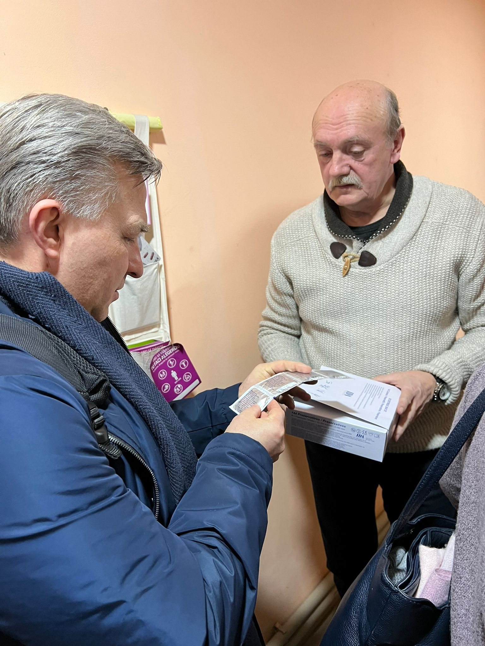
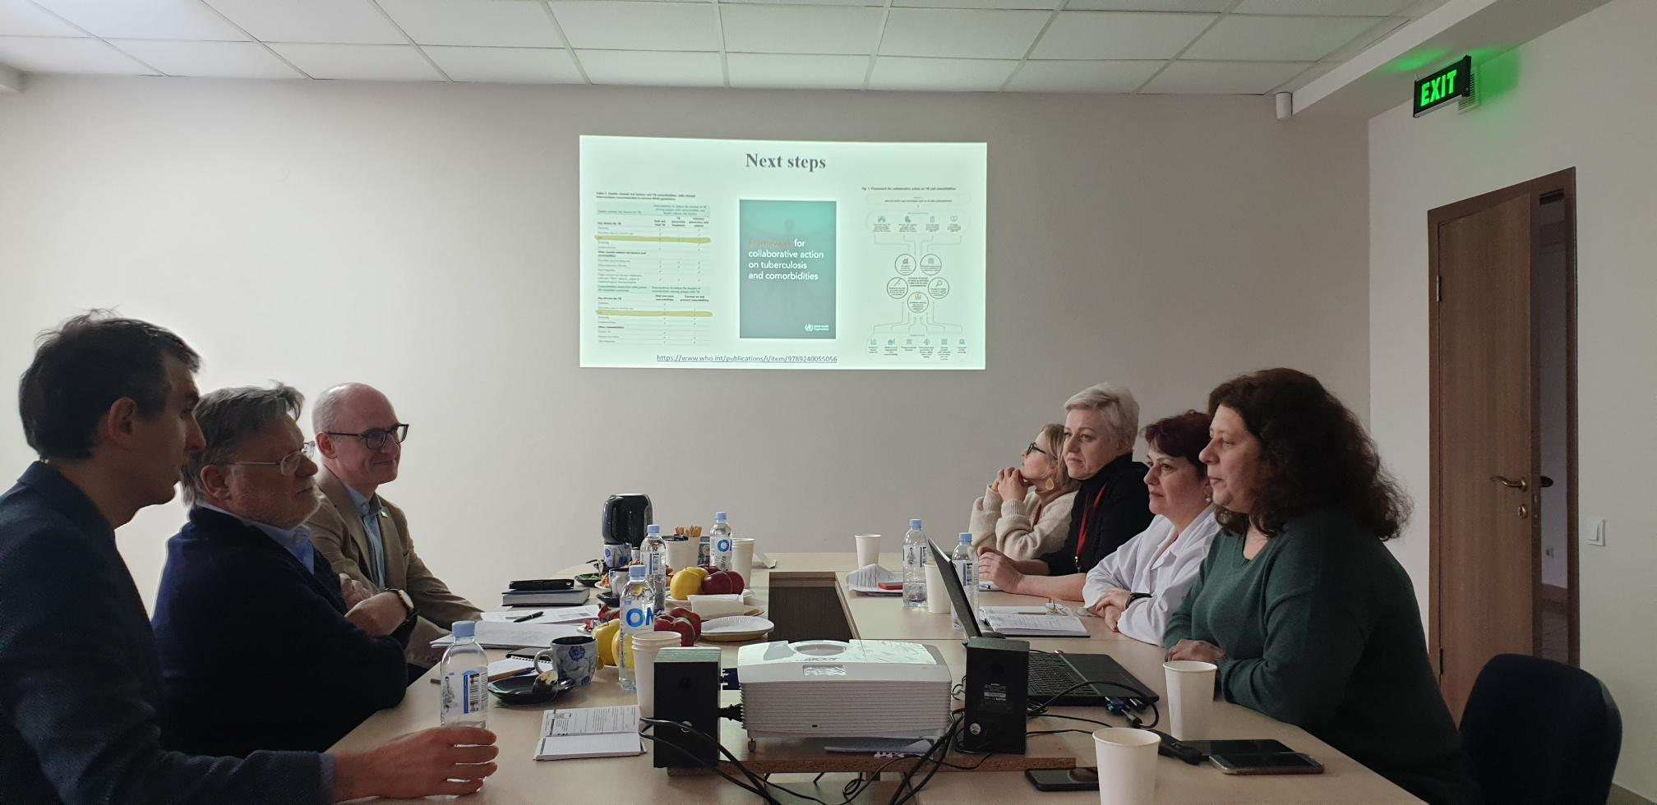
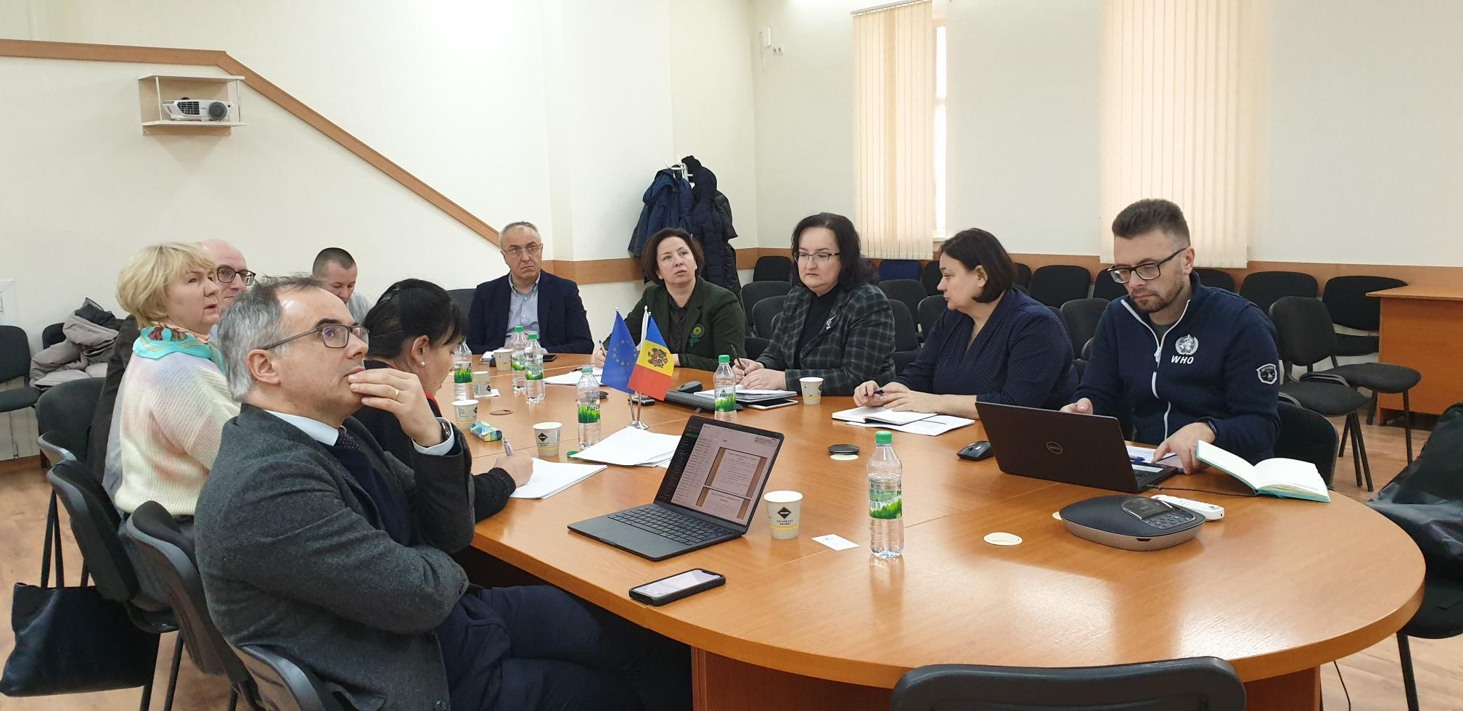
Thank you

